Slide 1


Application of molecular data science to study phthalate plasticizers
Team: Orion Dollar, Nisarg Joshi, Yunping Huang
Sponsor: Cargill

Slide 2
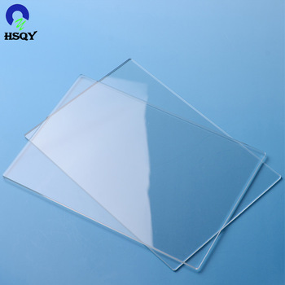
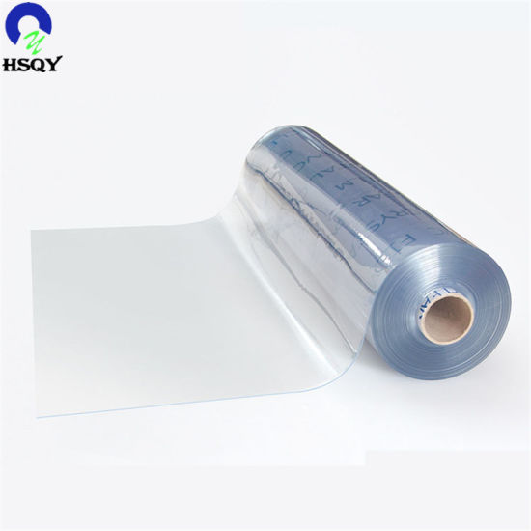
What are plasticizers?
It is an additive added into plastics to increase their plasticity and processability
Plasticizer
Hard plastic
Flexible plastic

Slide 3


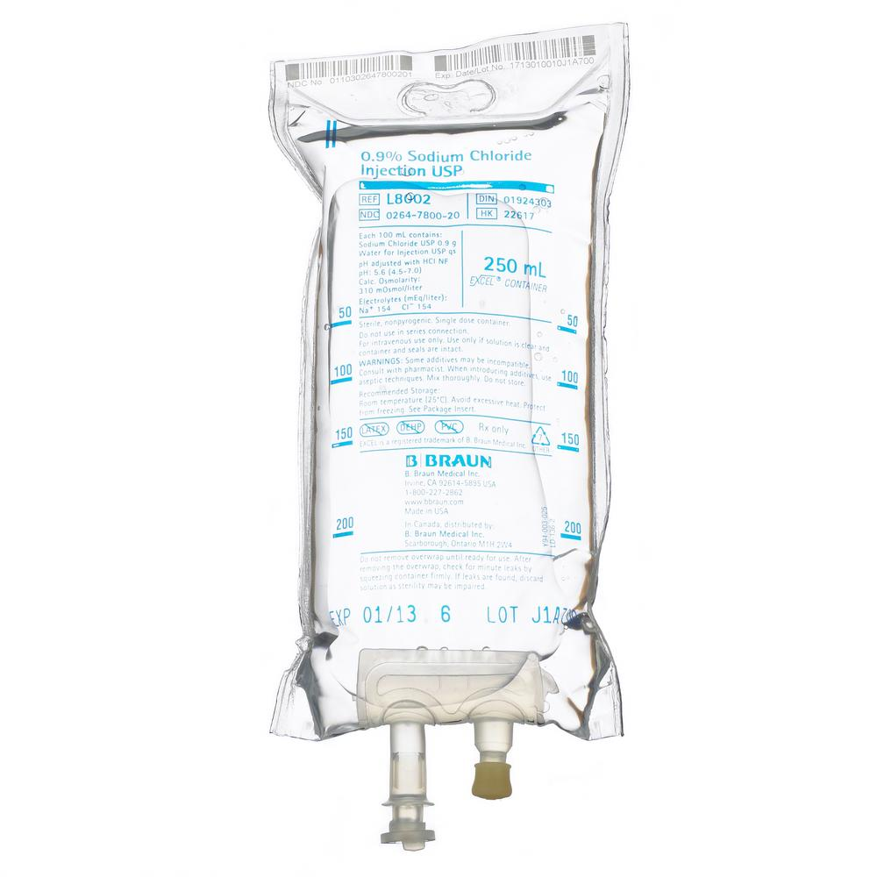

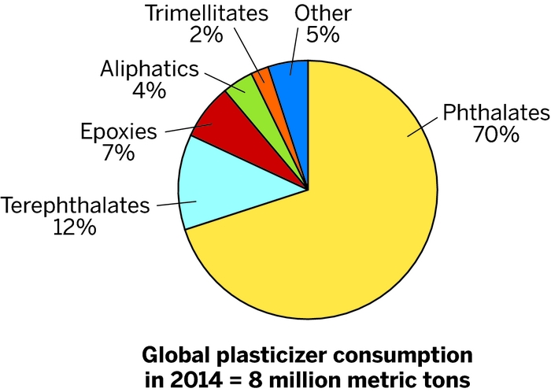
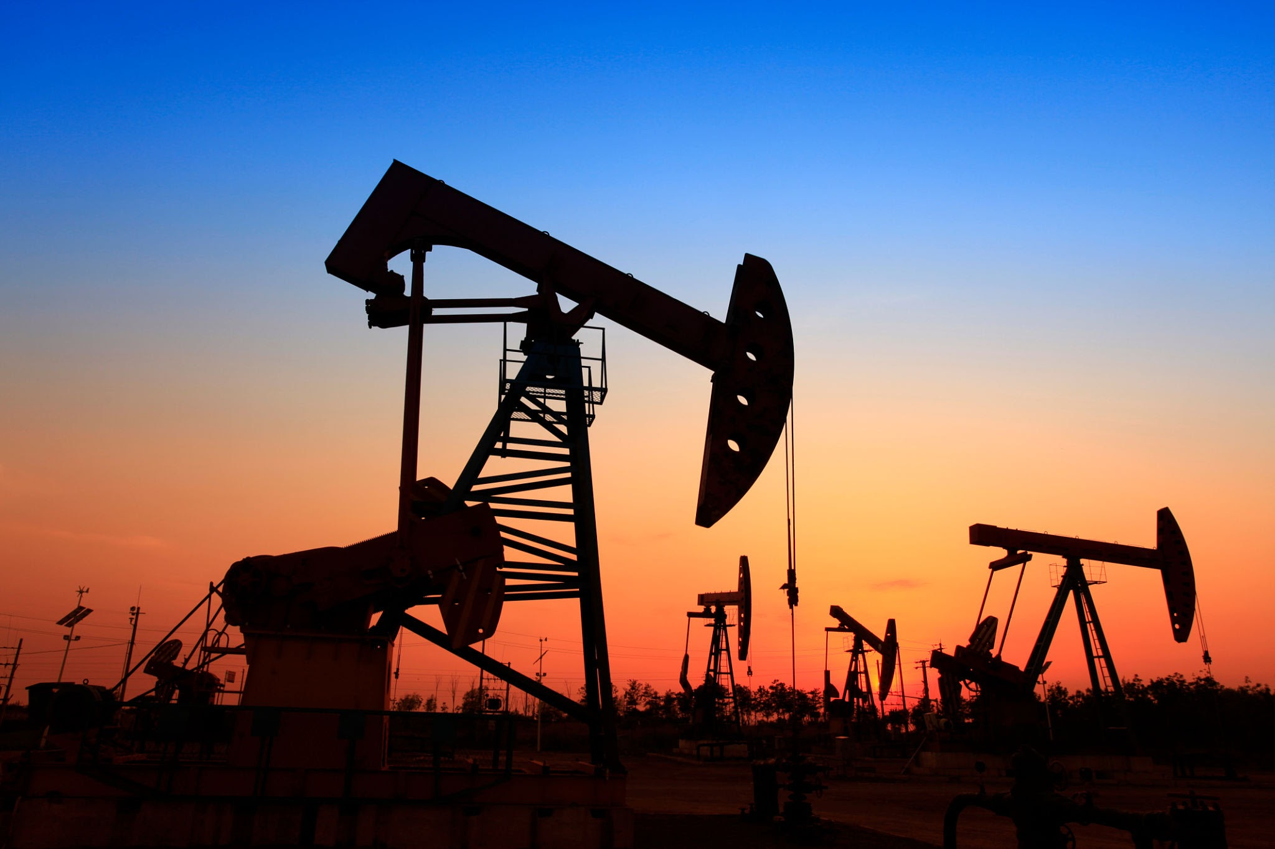
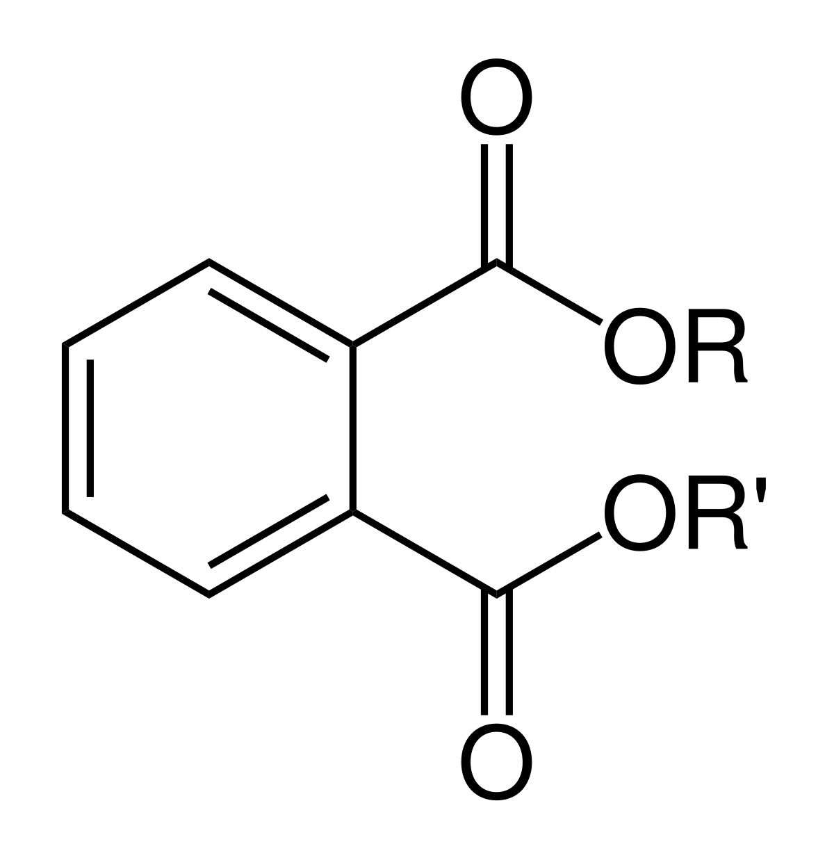
Current challenges
The most used plasticizer, phthalates raise concerns regarding toxicity and depletion
Reproductive
hazardous
Carcinogenic
In toys
In medical devices
Toxic but widely used
Phthalate
Phthalates are down-stream products in petroleum industry

Slide 4
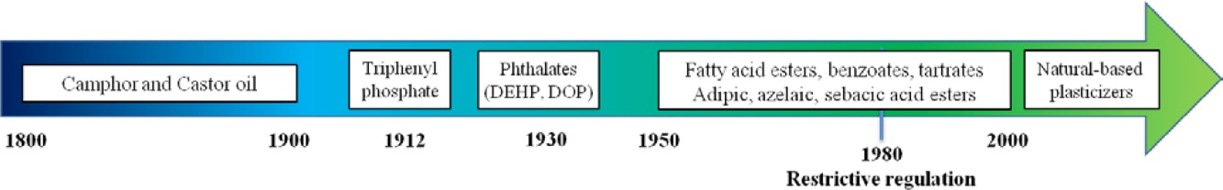
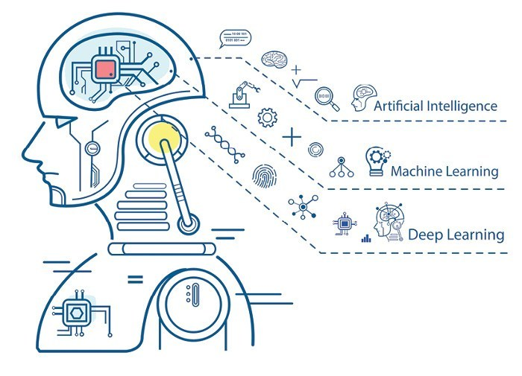
Accelerate R&D with data science
Currently most used category
Ideal plasticizer
Non-toxic
Bio-based
https://onlinelibrary.wiley.com/doi/10.1002/pola.27917
Machine learning sees thing from different aspects compared to human, providing different insights that accelerate research and discoveries.

Slide 5
Project use cases
In this project we are building a toolkit that could be used in :
Discover new correlations between a molecules’ chemical features and its effectiveness as a plasticizer
Generate new molecules of high potentials as plasticizers
Assess the toxicity and synthesizability of the new molecules

Slide 6
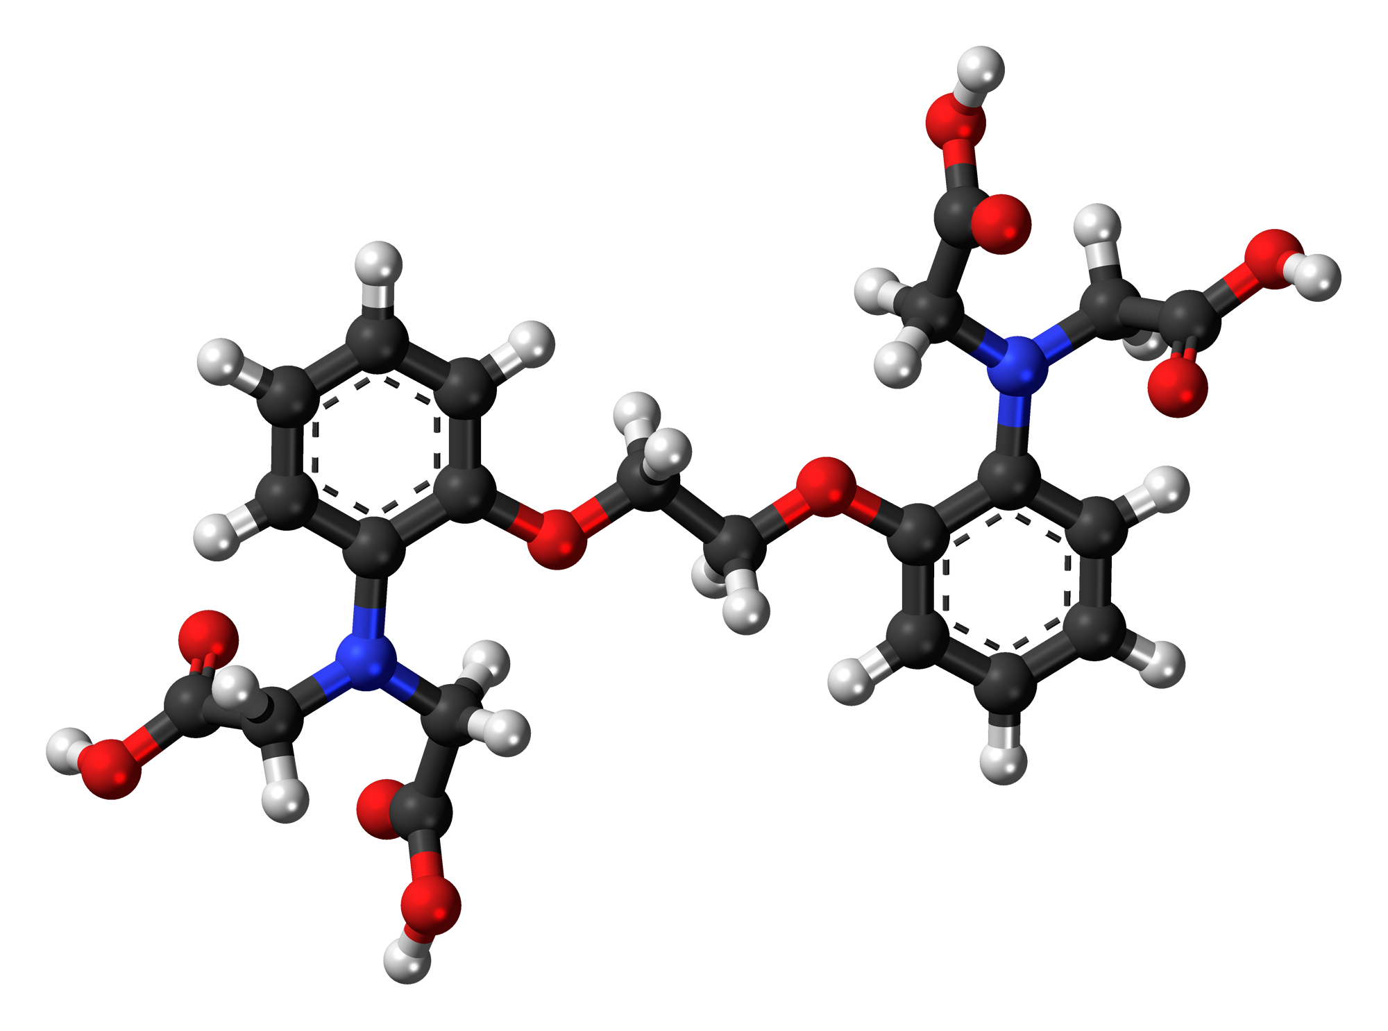
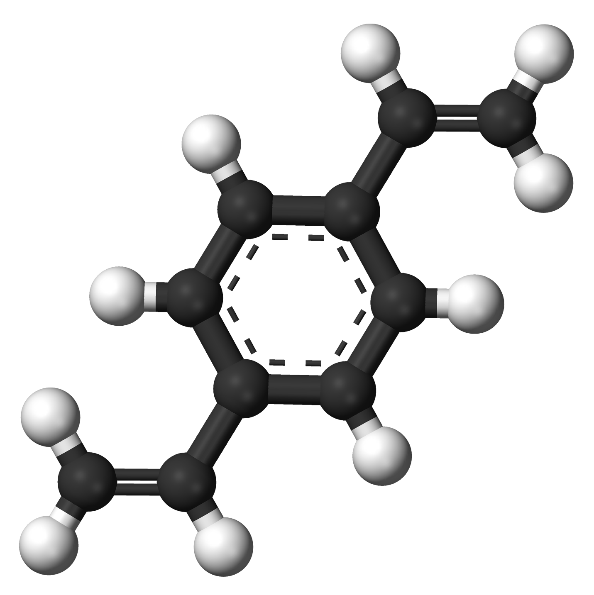
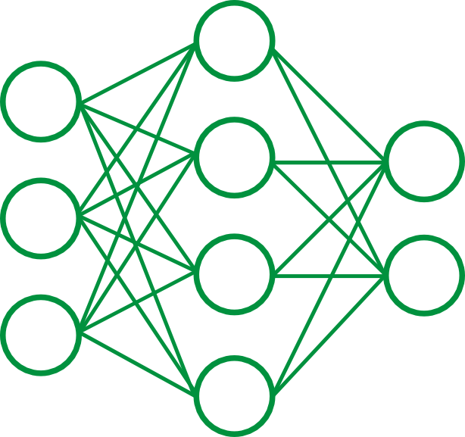

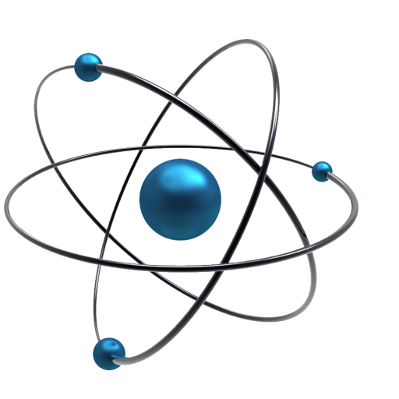
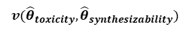
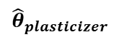
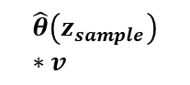
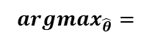
Proposed learning pipeline
2) Generate new plasticizers
Molecular Generation
$${argmax}_{\hat{θ}}=$$
Decoder
Reconstructed
SMILES
SMILES
Encoder
Feature Gen
Property
Predictor
$$v({\hat{θ}}_{toxicity},{\hat{θ}}_{synthesizability})$$
1) Chemical features and its effectiveness as a plasticizer
$${\hat{θ}}_{plasticizer}$$
3) Assess the toxicity and synthesizability
$$\hat{θ}\left(z_{sample}\right)∗v$$

Slide 7

Data source and methods
Three databases were used:
Knovel
Plasticizers
PubChem
Organics
GDB-17
Chemical structures were converted to SMILES strings so that they are machine readable:
CCCCCOC(=O)CCC(=O)O
BrC1=C(NC(=O)C=C1)OCCOCCOC=N
C1=C(C2CO2)S(=O)(=O)C2=C(OCCO2)S1
BrC1=C2CC3(COCCO3)C(C=O)C2=CC=N1
C(=O)N1CCOC=O…
Chemical structures
SMILES strings
Machine learning

Slide 8
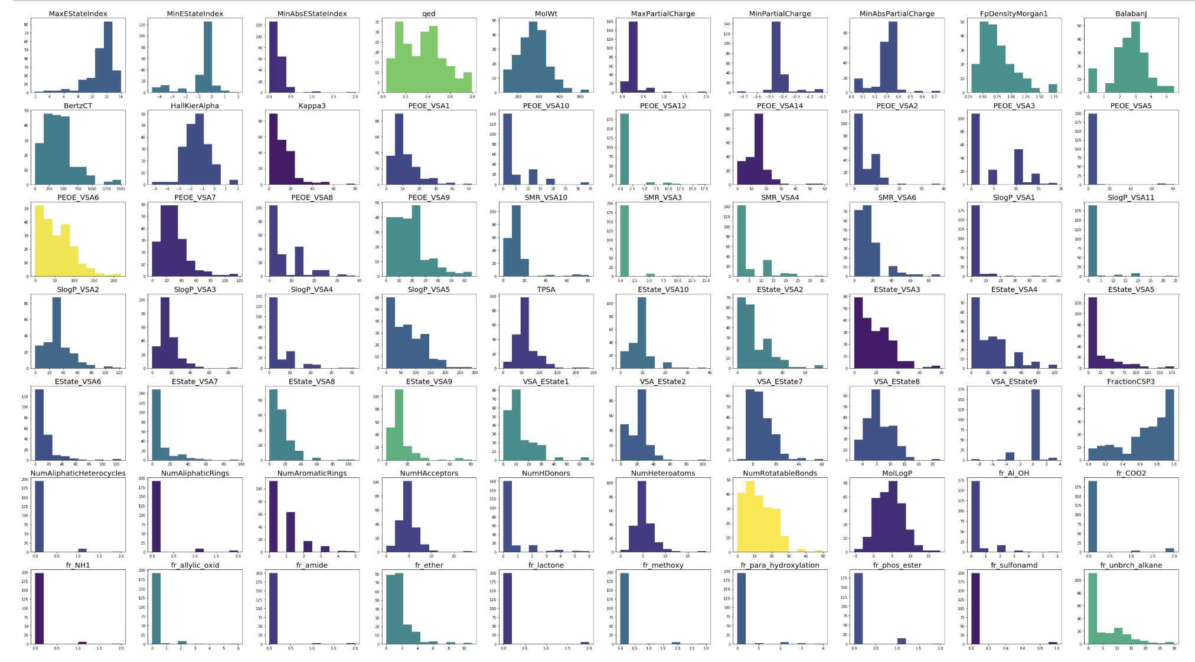
Data source and methods
We used RDKit to calculate molecular descriptor from inputted SMILES strings.
Distribution of chemical structural features

Slide 9
Data source and methods
Principal component analysis (PCA) of inputted SMILES strings:
Plasticizers
Random chemicals
SVM
Robust Covariance
Kernel Density Estimate
Best fit

Slide 10
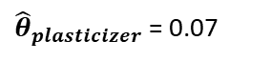
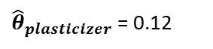
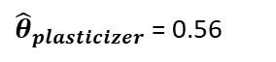
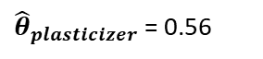
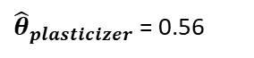
Data source and methods
Looking for potential candidates in the GDB-17 database
Top Candidate Molecules
${\hat{θ}}_{plasticizer}$ = 0.56
${\hat{θ}}_{plasticizer}$ = 0.56
${\hat{θ}}_{plasticizer}$ = 0.56
1st dimension captures enough variance
${\hat{θ}}_{plasticizer}$ = 0.12
${\hat{θ}}_{plasticizer}$ = 0.07
However, these samples are of low synthetic viability, considering the machine-generative nature of GDB-17 database

Slide 11
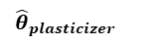
Data source and methods
Looking for potential candidates in the PubChem database
Fingerprints
Descriptors
Database ~66,000 organic compounds
Compounds are synthesized and reported in academic journals
Harder to get good split through PCA -> may need to explore labeled regression
${\hat{θ}}_{plasticizer}$
${\hat{θ}}_{plasticizer}$
0.889
0.216
0.888
0.214
0.888
0.214
0.888
0.214
0.888
0.213

Slide 12
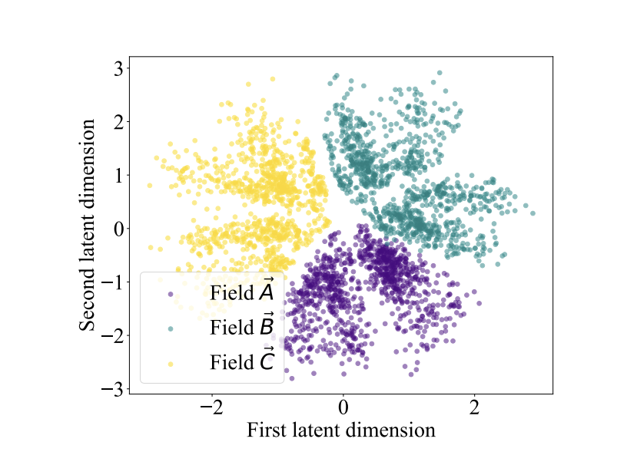
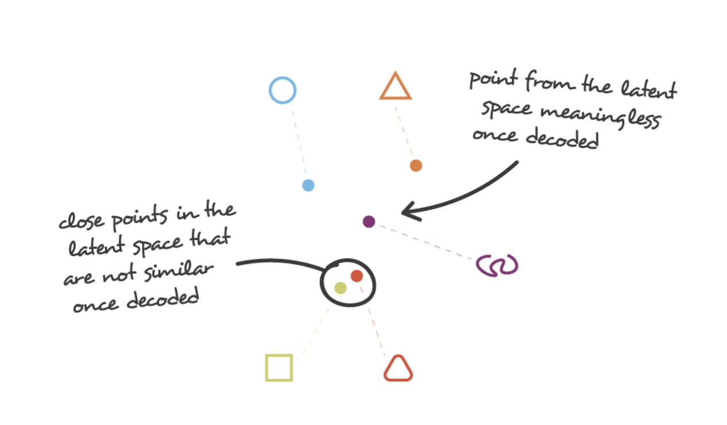
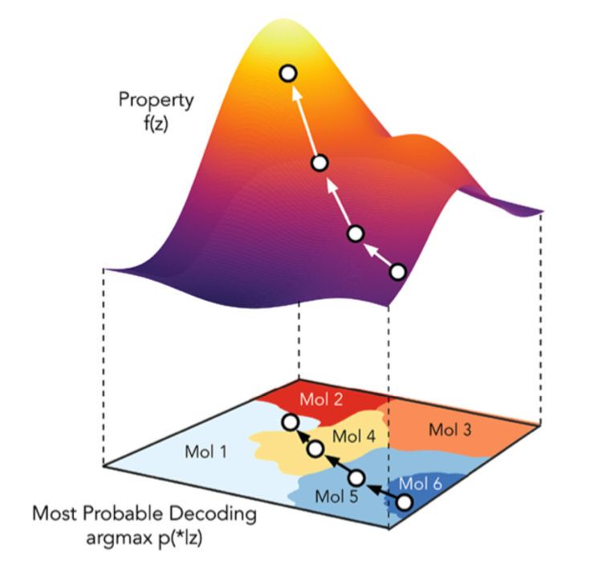
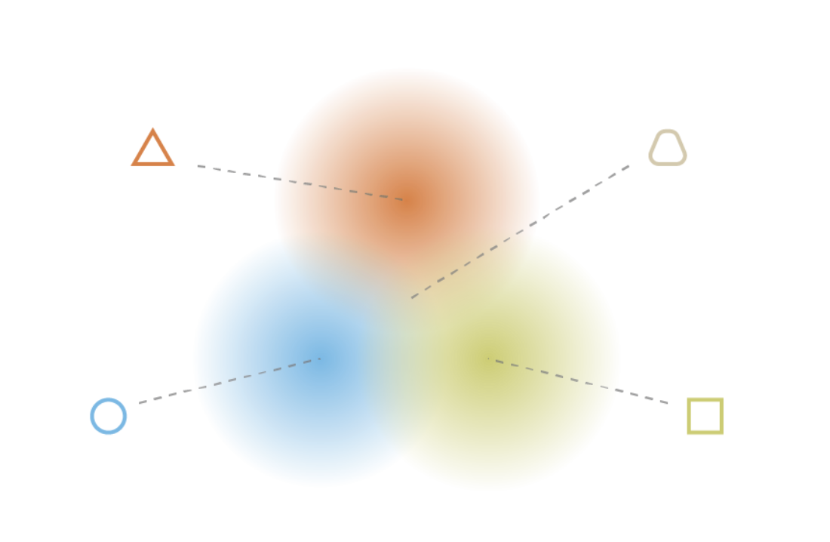
Data source and methods
Constructing continuous latent space using Variational Autoencoder (VAC)
Autoencoder
Discrete representations of molecules
CCCCCOC(=O)CCC(=O)O
BrC1=C(NC(=O)C=C1)OCCOCCOC=N
C1=C(C2CO2)S(=O)(=O)C2=C(OCCO2)S1
BrC1=C2CC3(COCCO3)C(C=O)C2=CC=N1
C(=O)N1CCOC=O…
OR
Method we used
SMILES strings
Variational Autoencoder
A multidimensional continuous representation

Slide 13
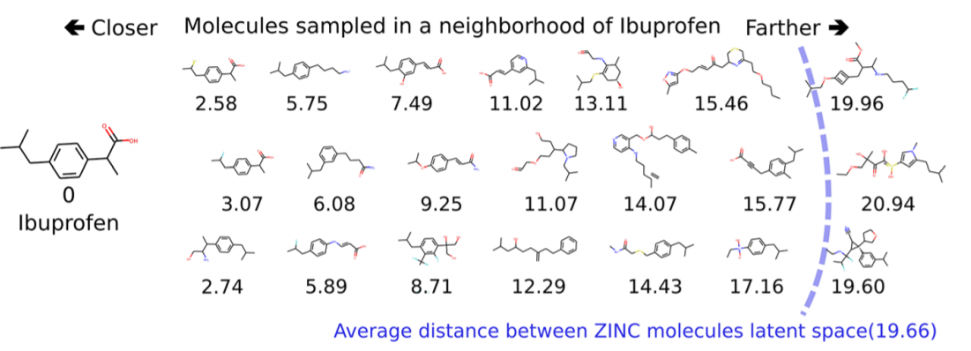
Data source and methods
Continuous representations of molecules allow us to automatically generate novel chemical structures by performing simple operations in the latent space, such as decoding random vectors.
https://pubs.acs.org/doi/pdf/10.1021/acscentsci.7b00572

Slide 14
Data source and methods
Evaluating the Loss Function
$$Loss=Reconstruction+KL Divergence+Property Prediction$$
Decoder
Reconstructed
SMILES
Encoder
SMILES
Backpropagation

Slide 15
Data source and methods
Minimizing the loss function
Effect of beta on model performance
Effect of architecture on model performance

Slide 16
Data source and methods
Feature selection using Lasso Regression
195 features generated from RDKIT
15 features for optimized organics and plasticizers
Lasso Regression

Slide 17
Data source and methods
Feature selection using Lasso Regression

Slide 18
Results and conclusions – predictive model
We started with 195 features for organics and plasticizers.
After training the model with the nonzero coefficients, we obtained 15 features with optimized plasticizers and organics accuracies:

Slide 19
Results and conclusions – predictive model

Slide 20
Results and conclusions – predictive model

Slide 21
Results and conclusions – predictive model

Slide 22
Results and conclusions – predictive model

Slide 23
Results and conclusions – generative model
Sample Reconstructions
-----Index 1-----
Target CCCCC(CC)COC(=O)CCCCCC(C)C
Output CCCCC(CC)COC(=O)CCCCCC(C)C
-----Index 2-----
Target CC(C)COP(=O)(OCC(C)C)OCC(C)C
Output CC(C)COP(=O)(OCC(C)C)OCC(C)C
-----Index 3-----
Target CCCCOP(=O)(OCCCC)OCCCC
Output CCCCOP(=O)(OCCCC)OCCCC
-----Index 4-----
Target C1=CC=C(C(=C1)C(=O)O)N2C(=NC=N2)CC3=CC=C(C=C3)O
Output C1=CC=C(C(=C1)C(=O)N)C2=NC=C(=2)CC3=CC=C(C=C3)O
-----Index 5-----
Target CC1=CC(=C2C3=C1OC4(C=C3C5=C(C2=O)C(=CC(=C5)O)O)C(=O)NC(=CC6=C(NC7=CC=CC=C76)C(C)(C)C=C)C(=O)N4)O
Output CC1=CC(=O2C3=C1CC43C(C4C(=33C(=O)C5=C((=C5O5)O)C()O)OCC(CCC=C(CCCCCCCCC)O)O)O)CCCC=C(C=C(=O)OC)C)C
-----Index 6-----
Target C(C(CO)(CO)COCC(CO)(CO)CO)O
Output C(C(CO)(CO)COCC(CO)(CO)CO)O
-----Index 7-----
Target CCCCCCCCCCCCCCCCOC(=O)C
Output CCCCCCCCCCCCCCCCOC(=O)C
-----Index 8-----
Target CC1=NOC(=C1SC#N)N
Output CC1=C(C(=N1)1=C)N
-----Index 9-----
Target CCC(CC1=CC=C(C=C1)Cl)N
Output CCC(CC1=CC=C(C=C1)O)N
-----Index 10-----
Target CC1C(C2(C3C4C1(C5C=C(C(=O)C5(C(C6(C4O6)CO)O)O)C)OC(O3)(O2)C7=CC=CC=C7)C(=C)C)OC(=O)C=CC8=CC=CC=C8
Output CCN1CC2(C3C4CC(C5C=C(C(=O)C5(C(C6(C4O6)CO)O)O)C)OC(O3)(O2)C7=CC=CC=C7)C(=C)C)OC(=O)C=CC8CCC=CC=C8

Slide 24
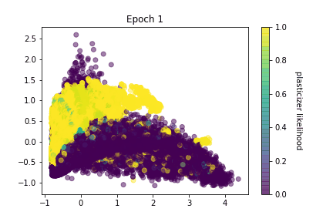
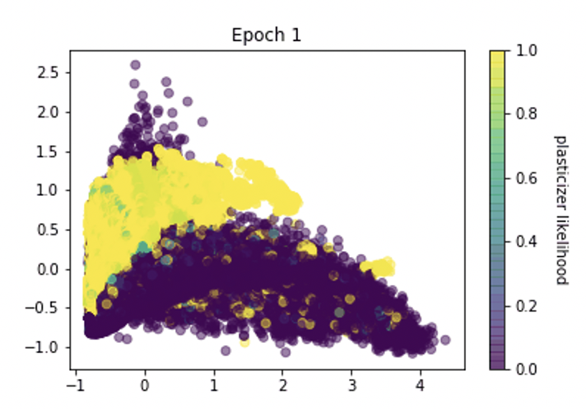
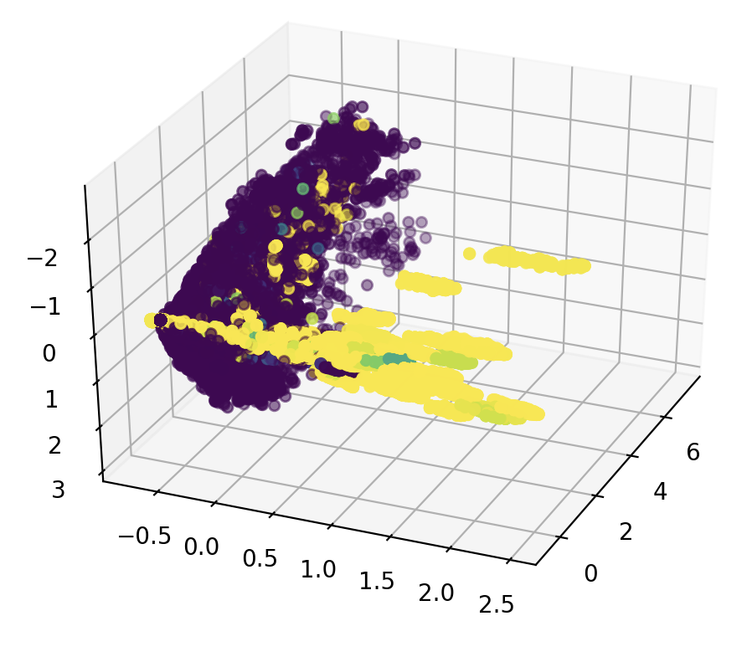
Results and conclusions – generative model
Latent Space Reorganization

Slide 25
Results and conclusions – generative model
Latent Space Reorganization

Slide 26
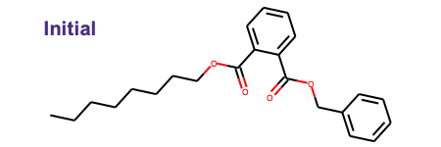
Results and conclusions – generative model
Latent Space Reorganization
Interpolating b/w Molecular Structures

Slide 27
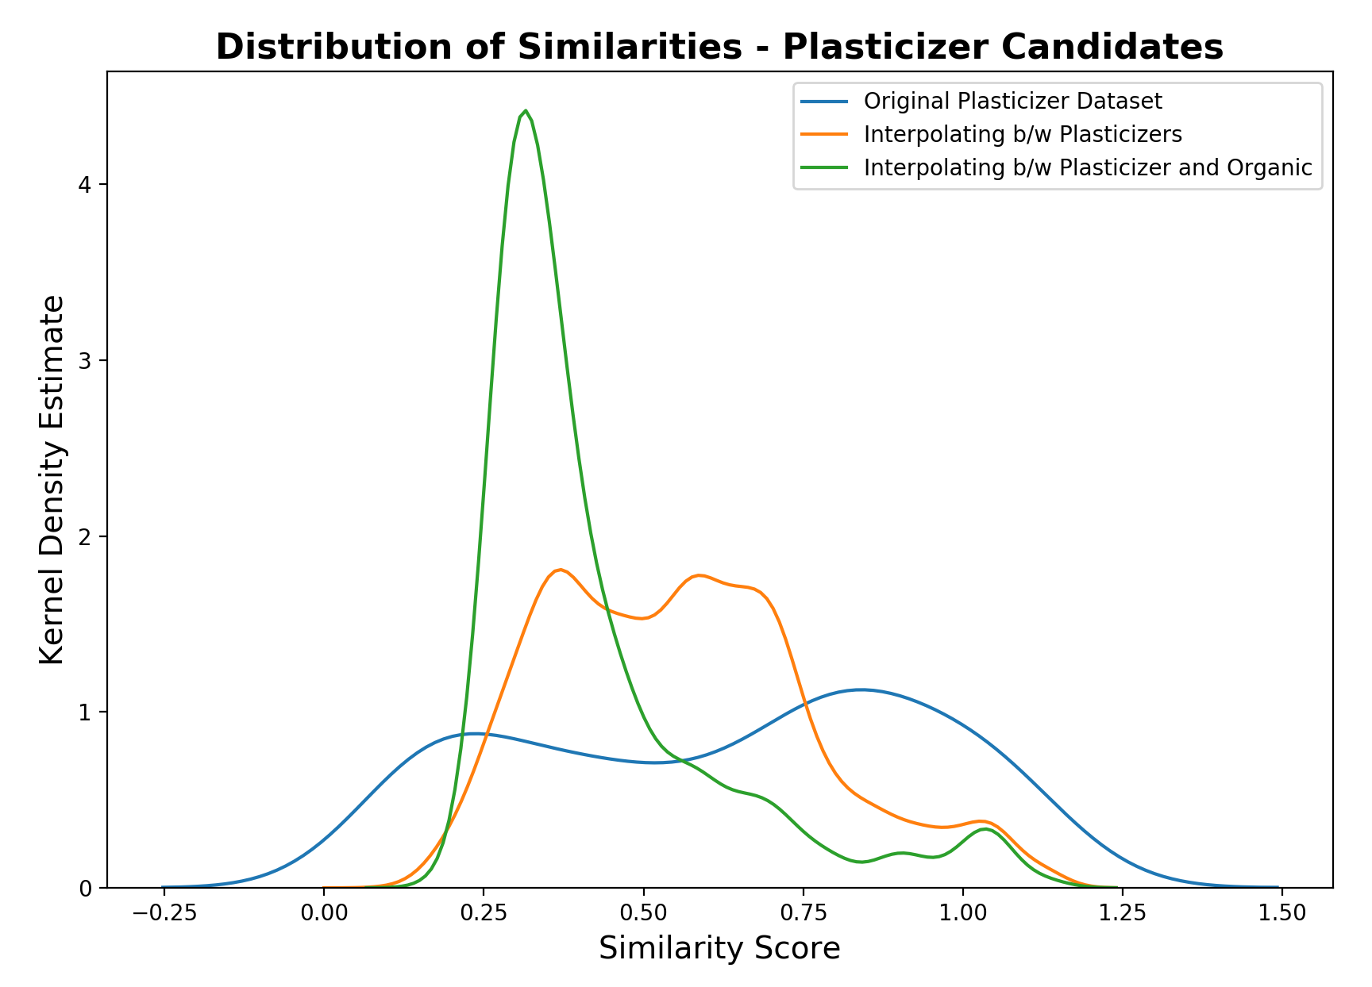
Results and conclusions – generative model
Diversity
Interpolating b/w known plasticizers and set of PubChem organic molecules leads to large increase in diversity of generated molecules
Realism can be improved by achieving better reconstruction on non-plasticizers and rewarding model for realism in loss function

Slide 28
Results and conclusions – generative model
We analyzed the features for the new generated molecules and used Lasso Regression again for them.

Slide 29
Results and conclusions – generative model

Slide 30
Results and conclusions – generative model

Slide 31
Results and conclusions – generative model

Slide 32
Future works
Improve latent encodings of non-plasticizers to enable model to explore a wider variety of new molecules
Improve embedded property by including term that accounts for differences in quality b/w plasticizers

